Slide 1

Deep Learning on Images/Videos

Slide 2
Contents
Deep Learning on Images/Videos
Convolution Neural Networks
Architecture of CNNs
Convolution operation
Pooling operation
Power of CNNs

Slide 3
Video is Collection of Multiple Images
Video is a sequence of images (called frames)
Sequence of images are displayed at certain frequency (fps) to make it appear like a video
Analysis of a video can be carried out by taking frames out of it

Slide 4
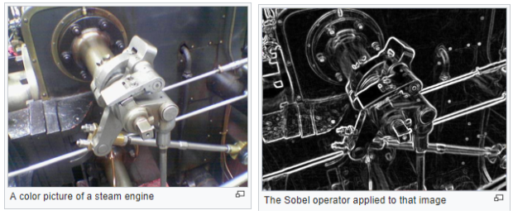
Making Deductions from an Image
To perform a particular task on an image, some features of the image are required
Filters are used to extract useful features from an image
Simply put, filter is a mathematical operation on the pixels of an image which transforms the image
Pixels of transformed image are used to perform the given task on the image
Question: Where is learning here ?

Slide 5
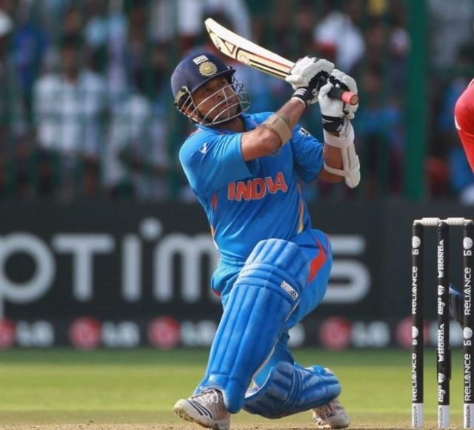
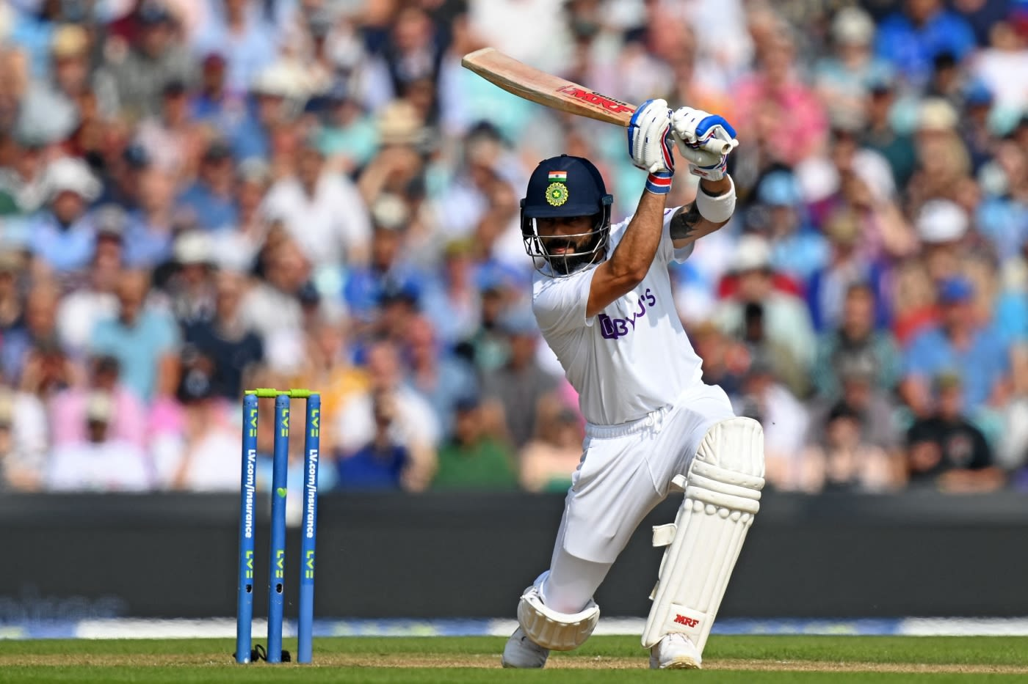
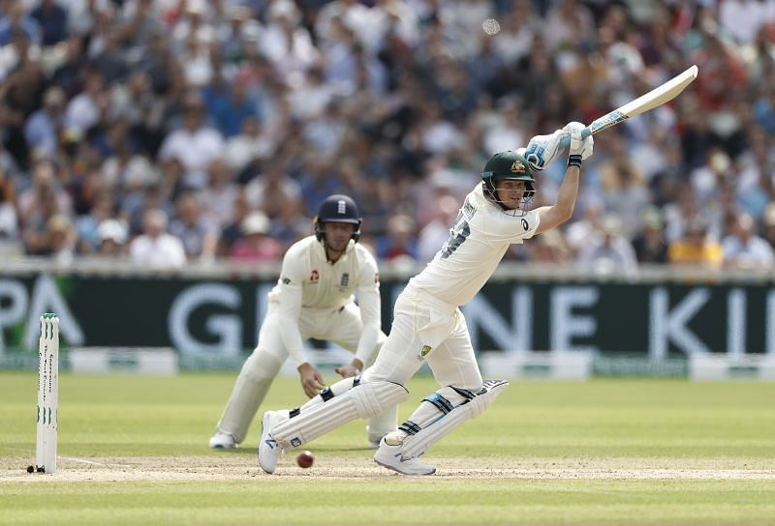
Learning filters for Feature Extraction
In practice, it is not known which filter gives the features required for the task
Idea: To learn the required filter from data
Example: Learning to identify a batsman in an image
Extract features from different images which will enable the computer to recognise a batsman in general

Slide 6
Learning filters for Feature Extraction
In general, multiple layers of filters are required to extract different levels of features for the task
Features at higher level depend on features at lower level
An analogy:
Suppose we are reading a paragraph of text
Consists of lines, words and characters
Reading and understanding a paragraph involves:
Interpreting set of characters as a word
Interpreting the meaning conveyed by set of words in a line
Interpreting the overall context and meaning of a set of lines
To perform this layered featured extraction using filters, a neural network called Convolution Neural Network (CNN) is used in DL

Slide 7
Convolution Neural Networks

Slide 8
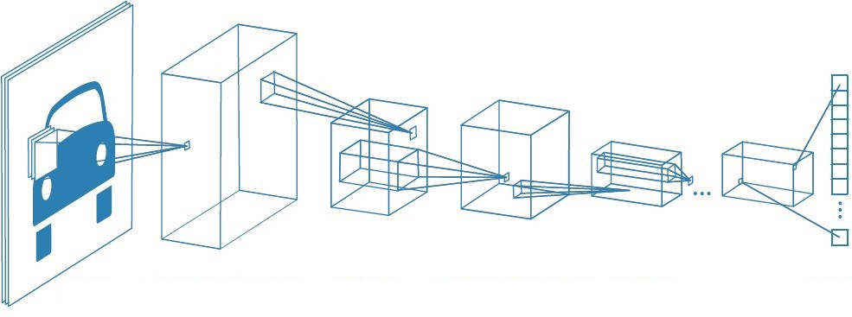
CNN Architecture
Convolution Layer
Convolution
layer
Pooling
layer
Pooling
Layer
Flattening
Input layer
Image Source: A Comprehensive Guide to Convolutional Neural Networks — the ELI5 way | by Sumit Saha | Towards Data Science

Slide 9
Components of CNN
Generally a CNN has the following components:
Input layer
Convolution layers
Activation layers
Pooling layers
Flattening
Output layer

Slide 10
Components of CNN
Generally a CNN has the following components:
Input layer – Image is fed in the form of pixel data
Convolution layers
Activation layers
Pooling layers
Flattening
Output layer

Slide 11
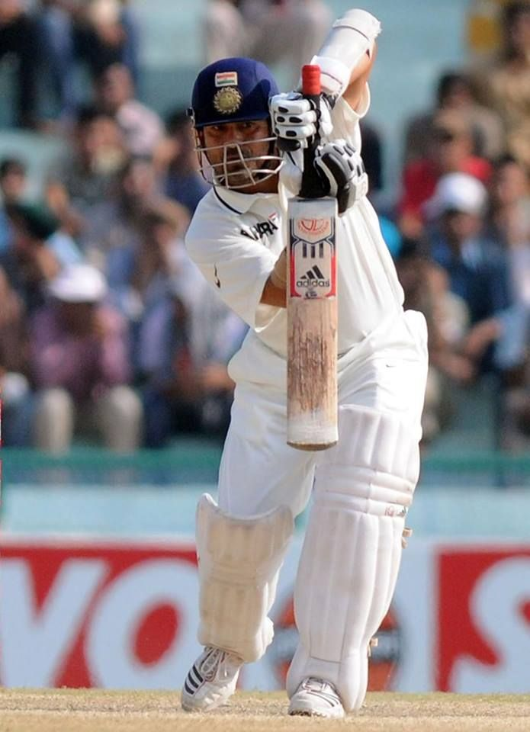
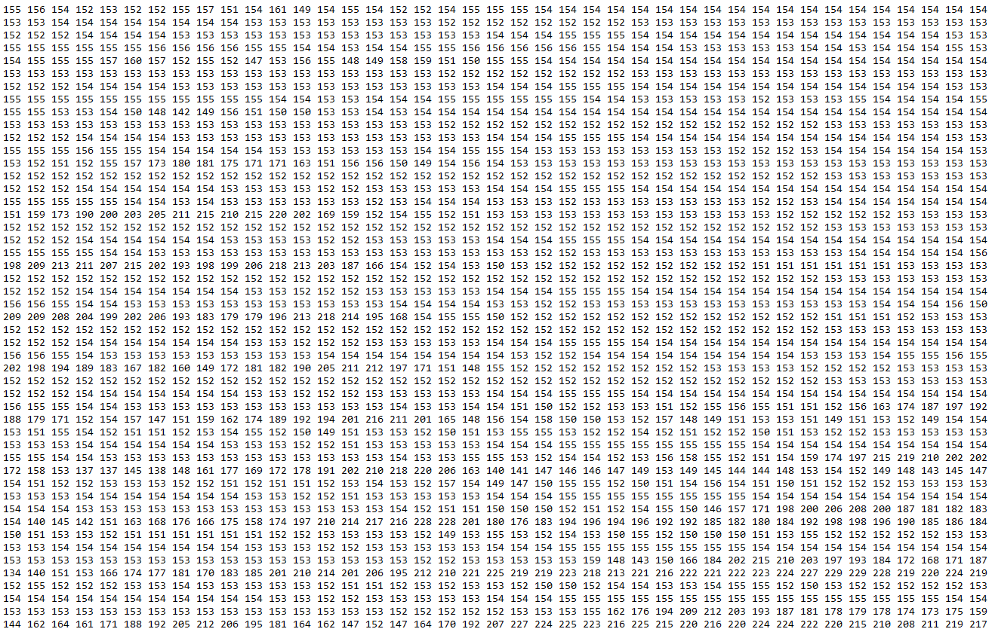
Image as Pixel Data

Slide 12
Components of CNN
Generally a CNN has the following components:
Input layer
Convolution layers – Convolution filters are passed over pixel data of images
Activation layers
Pooling layers
Flattening
Output layer

Slide 13
Convolution Filters
A Simple Convolution Example
Filter contains a set of weights arranged as an array
Filter moves as a sliding window on the input
Corresponding values are multiplied and added to get an output
An output is obtained each time the filer is slided
$$\begin{matrix}x_{11} & x_{12} & x_{13} & x_{14} \\ x_{21} & x_{22} & x_{23} & x_{24} \\ x_{31} & x_{32} & x_{33} & x_{34}\end{matrix}$$
$$\begin{matrix}y_{11} & y_{12} \\ y_{21} & y_{22}\end{matrix}$$
Filter $(2×2)$
Input $(3×4)$

Slide 14
Convolution Filters
A Simple Convolution Example
Filter contains a set of weights arranged as an array
Filter moves as a sliding window on the input
Corresponding values are multiplied and added to get an output
An output is obtained each time the filer is slided
$$\begin{matrix}x_{11} & x_{12} & x_{13} & x_{14} \\ x_{21} & x_{22} & x_{23} & x_{24} \\ x_{31} & x_{32} & x_{33} & x_{34}\end{matrix}$$
$$\begin{matrix}y_{11} & y_{12} \\ y_{21} & y_{22}\end{matrix}$$
Filter $(2×2)$
Input $(3×4)$
$$x_{11}y_{11}+x_{12}y_{12}+x_{21}y_{21}+x_{22}y_{22}$$
Output $(2×3)$

Slide 15
Convolution Filters
A Simple Convolution Example
Filter contains a set of weights arranged as an array
Filter moves as a sliding window on the input
Corresponding values are multiplied and added to get an output
An output is obtained each time the filer is slided
$$\begin{matrix}x_{11} & x_{12} & x_{13} & x_{14} \\ x_{21} & x_{22} & x_{23} & x_{24} \\ x_{31} & x_{32} & x_{33} & x_{34}\end{matrix}$$
$$\begin{matrix}y_{11} & y_{12} \\ y_{21} & y_{22}\end{matrix}$$
Filter $(2×2)$
Input $(3×4)$
$$x_{11}y_{11}+x_{12}y_{12}+x_{21}y_{21}+x_{22}y_{22}$$
$$x_{12}y_{11}+x_{13}y_{12}+x_{22}y_{21}+x_{23}y_{22}$$
Output $(2×3)$

Slide 16
Convolution Filters
A Simple Convolution Example
Filter contains a set of weights arranged as an array
Filter moves as a sliding window on the input
Corresponding values are multiplied and added to get an output
An output is obtained each time the filer is slided
$$\begin{matrix}x_{11} & x_{12} & x_{13} & x_{14} \\ x_{21} & x_{22} & x_{23} & x_{24} \\ x_{31} & x_{32} & x_{33} & x_{34}\end{matrix}$$
$$\begin{matrix}y_{11} & y_{12} \\ y_{21} & y_{22}\end{matrix}$$
Filter $(2×2)$
Input $(3×4)$
$$x_{11}y_{11}+x_{12}y_{12}+x_{21}y_{21}+x_{22}y_{22}$$
$$x_{12}y_{11}+x_{13}y_{12}+x_{22}y_{21}+x_{23}y_{22}$$
$$x_{13}y_{11}+x_{14}y_{12}+x_{23}y_{21}+x_{24}y_{22}$$
Output $(2×3)$

Slide 17
Convolution Filters
A Simple Convolution Example
Filter contains a set of weights arranged as an array
Filter moves as a sliding window on the input
Corresponding values are multiplied and added to get an output
An output is obtained each time the filer is slided
$$\begin{matrix}x_{11} & x_{12} & x_{13} & x_{14} \\ x_{21} & x_{22} & x_{23} & x_{24} \\ x_{31} & x_{32} & x_{33} & x_{34}\end{matrix}$$
$$\begin{matrix}y_{11} & y_{12} \\ y_{21} & y_{22}\end{matrix}$$
Filter $(2×2)$
Input $(3×4)$
$$x_{11}y_{11}+x_{12}y_{12}+x_{21}y_{21}+x_{22}y_{22}$$
$$x_{12}y_{11}+x_{13}y_{12}+x_{22}y_{21}+x_{23}y_{22}$$
$$x_{13}y_{11}+x_{14}y_{12}+x_{23}y_{21}+x_{24}y_{22}$$
$$x_{21}y_{11}+x_{22}y_{12}+x_{31}y_{21}+x_{32}y_{22}$$
Output $(2×3)$

Slide 18
Convolution Filters
A Simple Convolution Example
Filter contains a set of weights arranged as an array
Filter moves as a sliding window on the input
Corresponding values are multiplied and added to get an output
An output is obtained each time the filer is slided
$$\begin{matrix}x_{11} & x_{12} & x_{13} & x_{14} \\ x_{21} & x_{22} & x_{23} & x_{24} \\ x_{31} & x_{32} & x_{33} & x_{34}\end{matrix}$$
$$\begin{matrix}y_{11} & y_{12} \\ y_{21} & y_{22}\end{matrix}$$
Filter $(2×2)$
Input $(3×4)$
$$x_{11}y_{11}+x_{12}y_{12}+x_{21}y_{21}+x_{22}y_{22}$$
$$x_{12}y_{11}+x_{13}y_{12}+x_{22}y_{21}+x_{23}y_{22}$$
$$x_{13}y_{11}+x_{14}y_{12}+x_{23}y_{21}+x_{24}y_{22}$$
$$x_{21}y_{11}+x_{22}y_{12}+x_{31}y_{21}+x_{32}y_{22}$$
$$x_{22}y_{11}+x_{23}y_{12}+x_{32}y_{21}+x_{33}y_{22}$$
Output $(2×3)$

Slide 19
Convolution Filters
A Simple Convolution Example
Filter contains a set of weights arranged as an array
Filter moves as a sliding window on the input
Corresponding values are multiplied and added to get an output
An output is obtained each time the filer is slided
$$\begin{matrix}x_{11} & x_{12} & x_{13} & x_{14} \\ x_{21} & x_{22} & x_{23} & x_{24} \\ x_{31} & x_{32} & x_{33} & x_{34}\end{matrix}$$
$$\begin{matrix}y_{11} & y_{12} \\ y_{21} & y_{22}\end{matrix}$$
Filter $(2×2)$
Input $(3×4)$
$$x_{11}y_{11}+x_{12}y_{12}+x_{21}y_{21}+x_{22}y_{22}$$
$$x_{12}y_{11}+x_{13}y_{12}+x_{22}y_{21}+x_{23}y_{22}$$
$$x_{13}y_{11}+x_{14}y_{12}+x_{23}y_{21}+x_{24}y_{22}$$
$$x_{21}y_{11}+x_{22}y_{12}+x_{31}y_{21}+x_{32}y_{22}$$
$$x_{22}y_{11}+x_{23}y_{12}+x_{32}y_{21}+x_{33}y_{22}$$
$$x_{23}y_{11}+x_{24}y_{12}+x_{33}y_{21}+x_{34}y_{22}$$
Output $(2×3)$

Slide 20
Convolution on an Image
Filter is slided on a matrix of pixel values of an image
Convolution filters are intelligent units which extract features from an image
Different features of the image can be extracted using appropriate filters
Filters can be designed to detect various features like horizontal & vertical edges, smoothness, texture etc.
1 | 0 | -1
1 | 0 | -1
1 | 0 | -1
-1 | -1 | -1
0 | 0 | 0
1 | 1 | 1
$3×3$ filter for horizontal edge detection
$3×3$ filter for vertical edge detection

Slide 21
Components of CNN
Generally a CNN has the following components:
Input layer
Convolution layers
Activation layers - Each of the values of output of convolution layer is passed through a function (activation function)
Pooling layers
Fully Connected layers
Output layer

Slide 22
Components of CNN
Generally a CNN has the following components:
Input layer
Convolution layers
Activation layers
Pooling layers
Flattening
Output layer

Slide 23
Pooling Operation

Slide 24
What is Pooling?
Intuition:
Pixels in an image mostly contain redundant information
Watch this video on YouTube: https://youtu.be/f1fXCRtSUWU
Object in the picture could be identified with a reduced image
Pooling operation is used on feature maps (after activation) to reduce the spatial size without loss of much information
Feature representation is made more compact with pooling

Slide 25
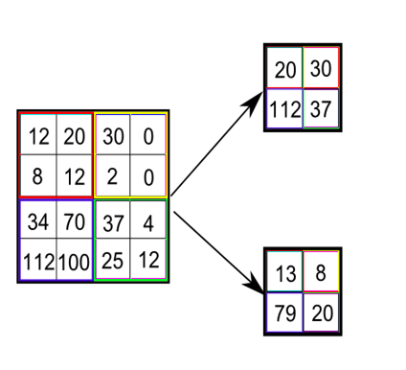
Pooling Filter and Types of Pooling
Like convolution, pooling is performed using a filter
Pooling filter slides over the feature map such that there is no overlap
Output of each slide depends on the type of filter
Types of pooling:
Max Pooling – most commonly used
Average pooling
Sum pooling
Max Pooling
Average Pooling

Slide 26
Components of CNN
Generally a CNN has the following components:
Input layer
Convolution layers
Pooling layers
Flattening
Output layer
Output of pooling layers is flattened
Flattened vector contains consolidated features extracted from an image
0
1
2
2
3
0
0
4
2
0 | 1 | 2
2 | 3 | 0
0 | 4 | 2
Flattening

Slide 27
Components of CNN
Generally a CNN has the following components:
Input layer
Convolution layers
Activation layers
Pooling layers
Flattening
Output layer – Using the features extracted from the image, necessary predictions are made in this layer

Slide 28
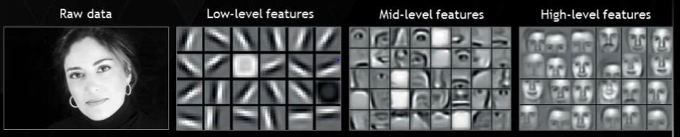
Feature Extraction using CNN
CNN has many layers of convolution filters which extract features
An illustration of how features are extracted when an image given to a CNN:
First layer extracts low level features
E.g., Vertical and horizontal edges
Second layer extracts little high level features such as skin, hair, nose, mouth etc. based on the textures.
Layers further up may identify faces, limbs, etc

Slide 29
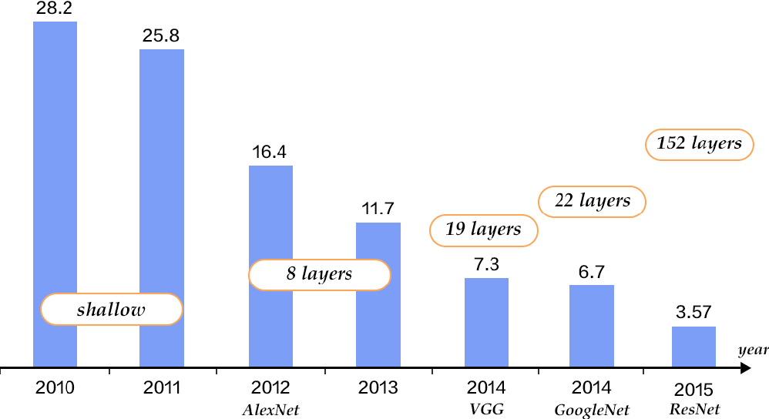
Power of CNNs: Image Net Challeneg
Image classification task with 1000 classes
Training data of 1.2 million images
Humans had an error rate of around 5%

Slide 30
Summary
Learning useful information from Images and Videos requires a special types of neural network known Convolution Neural Networks
CNNs have been very effective in extracting information from images and videos for making inferences from them
Most important components of a CNN include convolution and pooling layers
Various CNN architectures with different numbers of layers have been developed to enable computers to analyse images and making predictions based on images

Slide 31

THANK YOU

